Slide 1


Team 54: ECEN215 Lab Kit 2
Bi-Weekly Update 3
Gavin Bernard
Maylun Huang
Evan Slyter
Sponsor: John Lusher TA: Hailey Ward
Notes:
Michelle

Slide 2
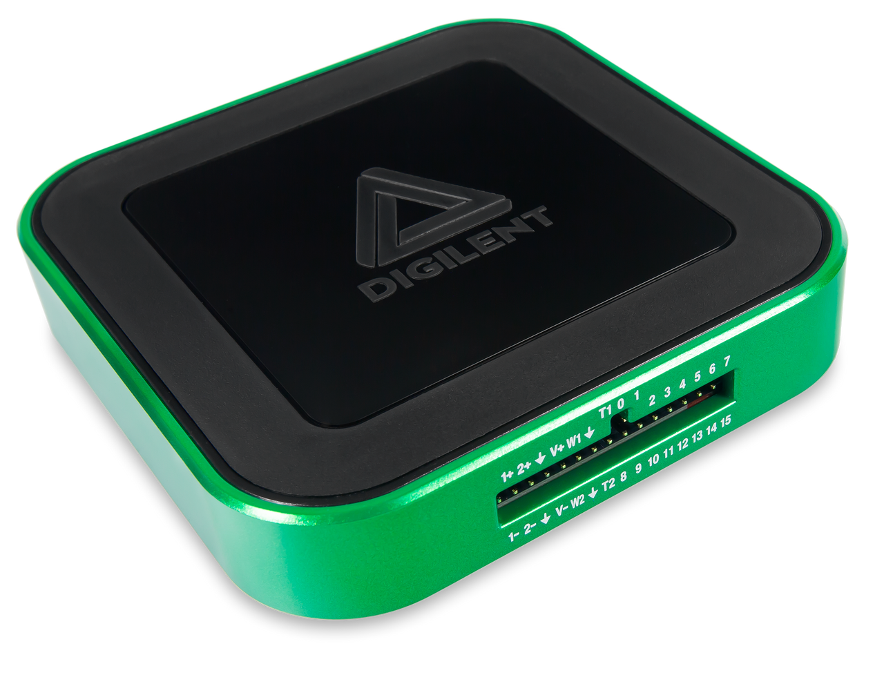
Project Summary
Problem statement:
Access to an affordable, course-specific solution for distance-learning students to complete ECEN215 Labs is minimal.
Our Solution:
An affordable, self-contained system that enables hands-on measurements and intuitive data displays.
Complete production of labkit for $50-$75
Easily transportable by hand.
AD3: $379
Notes:
Kyle

Slide 3
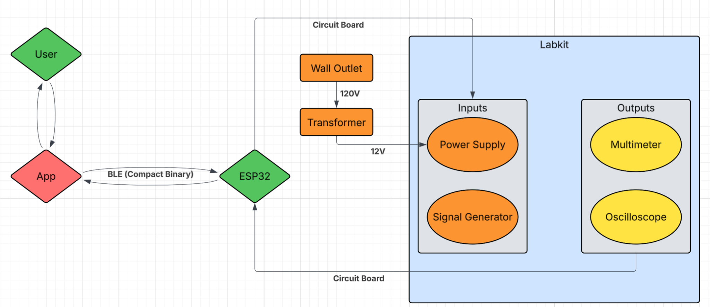
Project/System Overview
PCB
Software
Subsystem | Responsibility
Power Supply | Gavin Bernard
Signal Generator | Gavin Bernard
Mobile Application | Evan Slyter
Multimeter | Maylun Huang
Oscilloscope | Maylun Huang
Notes:
Eric

Slide 4
Project Timeline (45 sec)
1/26 | 2/9 | 2/23 | 3/16 | 3/30 | 4/20
Validate subsystems Phone-Phone BLE Validation | Finalize PCB & order Phone-MCU BLE Validation | Soldered PCB App Integration | Integration Complete Fully Coded | Final Validation | Final Demo
Notes:
Eric

Slide 5
Power Supply/Signal Generator Gavin Bernard
Accomplishments since last update 15 hrs of effort | Ongoing progress/problems and plans until the next presentation
Parts Arrived 12V to 5V soldered and tested on PerfBoard 12V to 3.3V soldered and tested on PerfBoard | Complete soldering and testing of subsystems this weekend on PerfBoard Complete integration of App

Slide 6
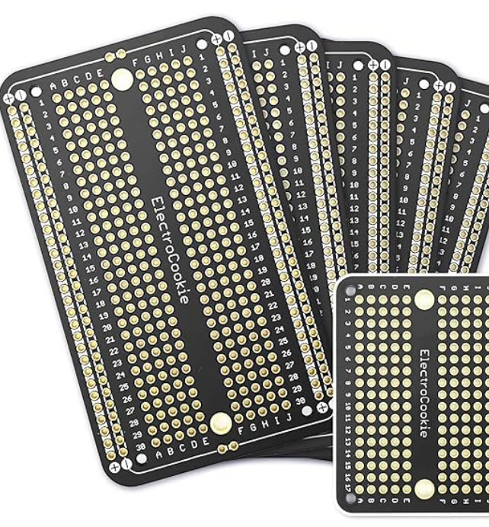
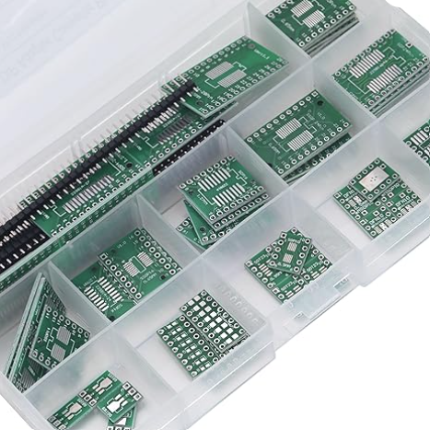
Power Supply/Signal Generator
Gavin Bernard

Slide 7
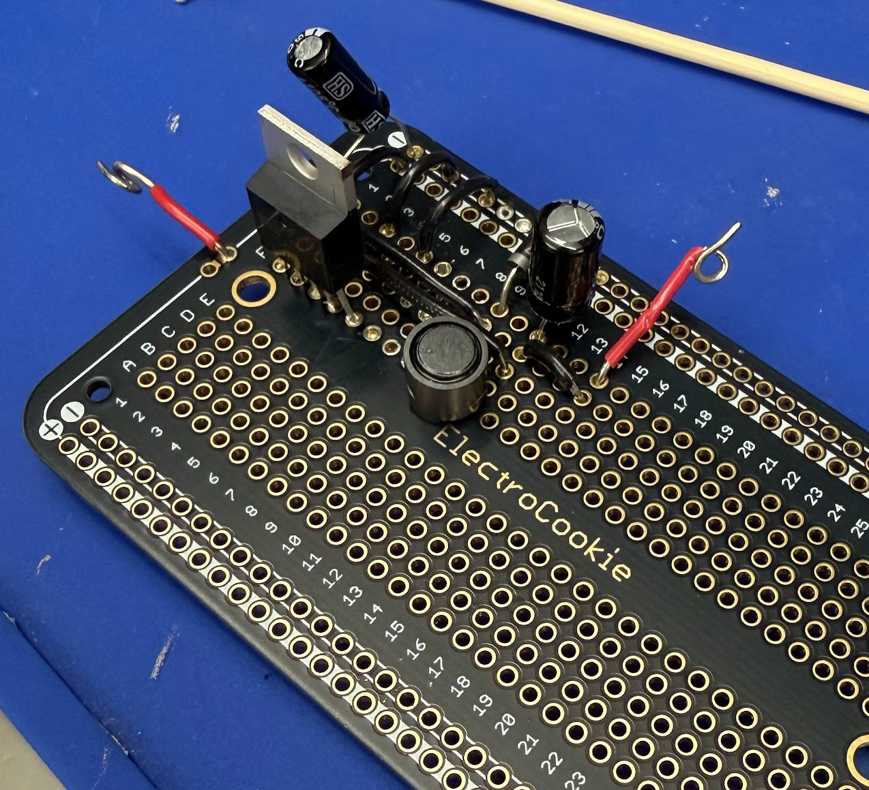
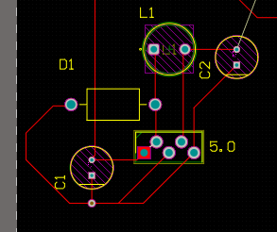
Power Supply/Signal Generator
Gavin Bernard

Slide 8
Measurement Subsystem Maylun Huang
Accomplishments since last update 25 hrs of effort | Ongoing progress/problems and plans until the next presentation
Completed PCB Integration with Power Supply, Signal Generator, and MCU | PCB assembly MCU–app communication

Slide 9
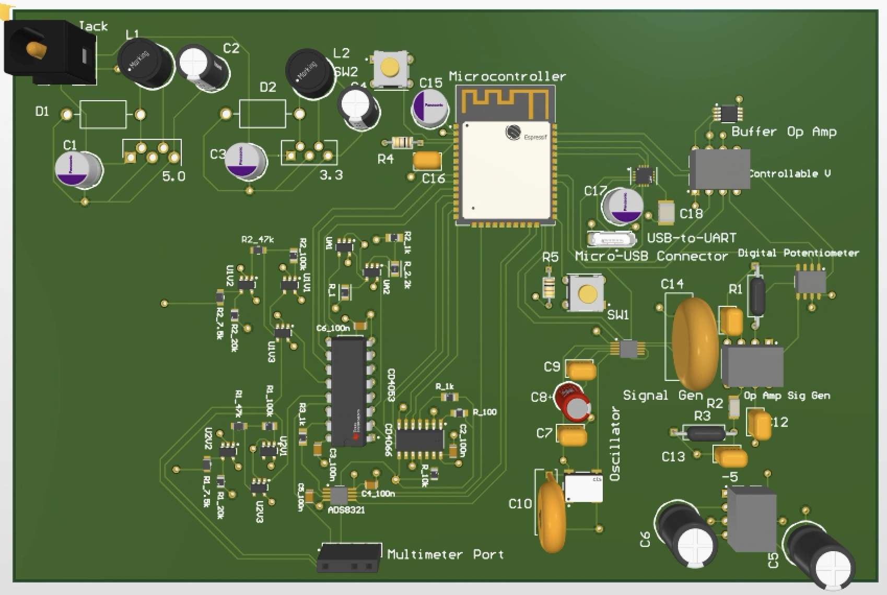
Measurement Subsystem Maylun Huang

Slide 10
Mobile App Evan Slyter
Accomplishments since last update 9 hrs of effort | Ongoing progress/problems and plans until the next presentation
-BLE advertiser detected from app -Sample commands sent from app to ESP32 Dev Kit -Temporary app page to test connection | -Working with teammates to get code more accurate while waiting for PCB. (Figuring out pins)

Slide 11
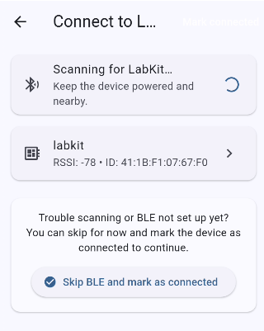
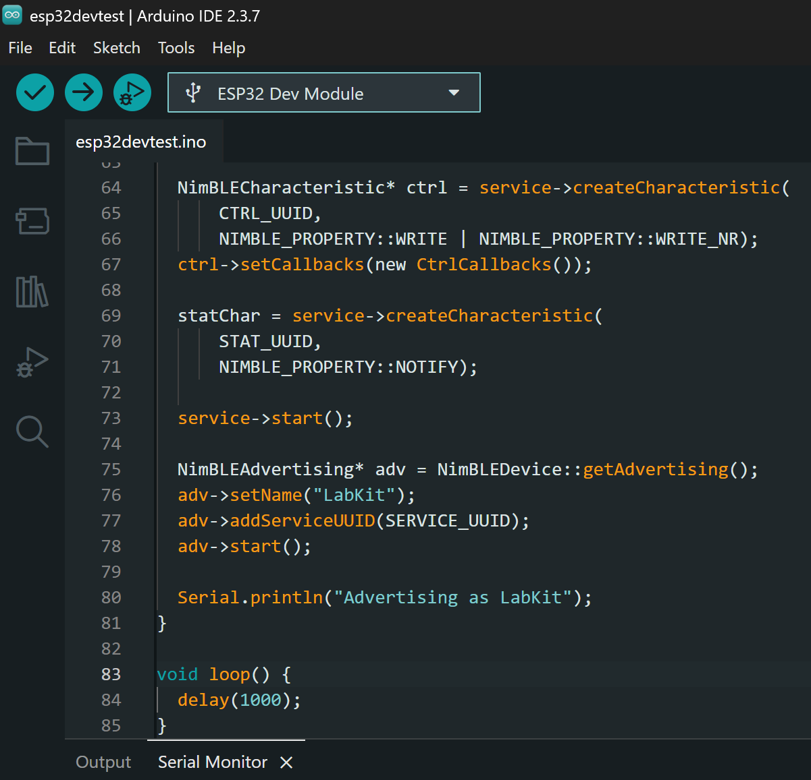
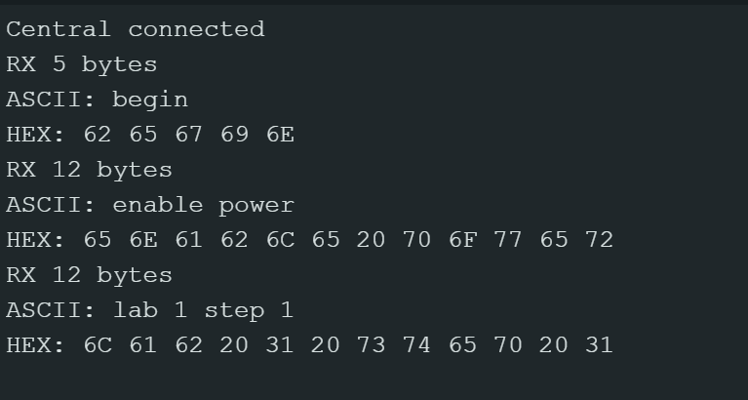
Mobile App Evan Slyter

Slide 12
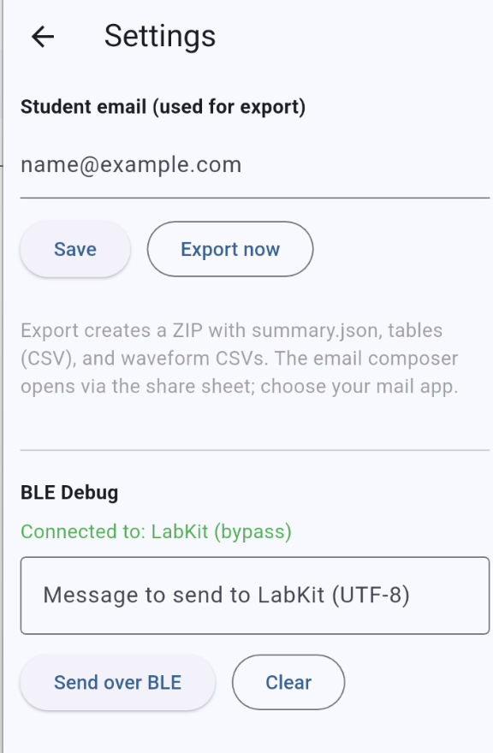
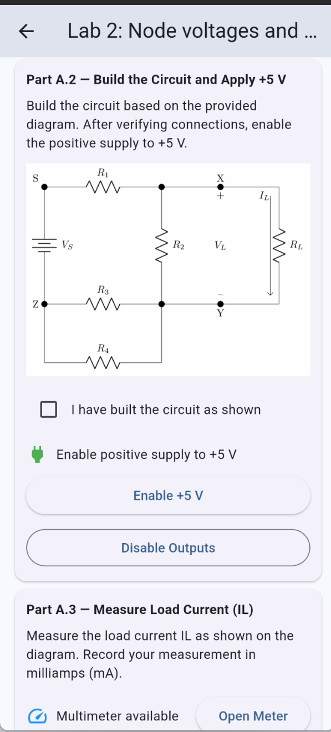
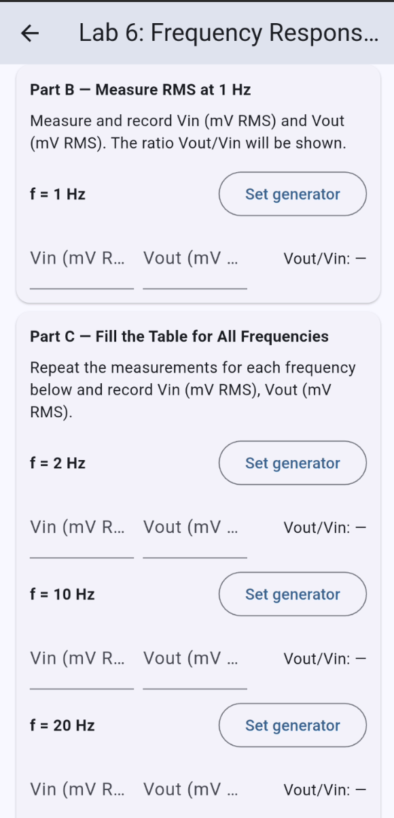
Mobile App Evan Slyter

Slide 13
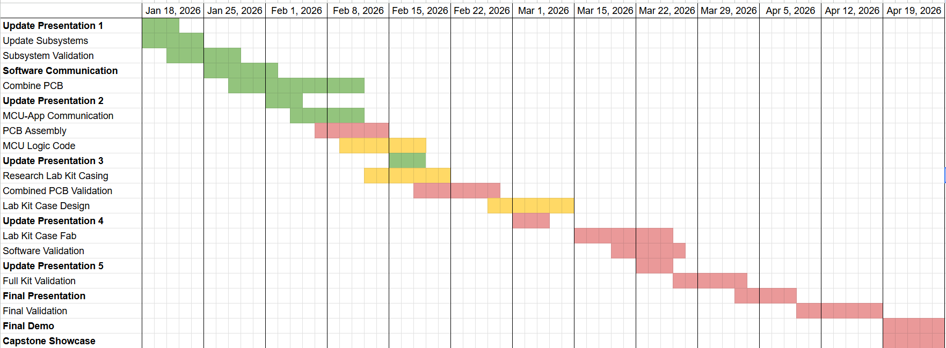
Execution Plan
Notes:
Michelle

Slide 14
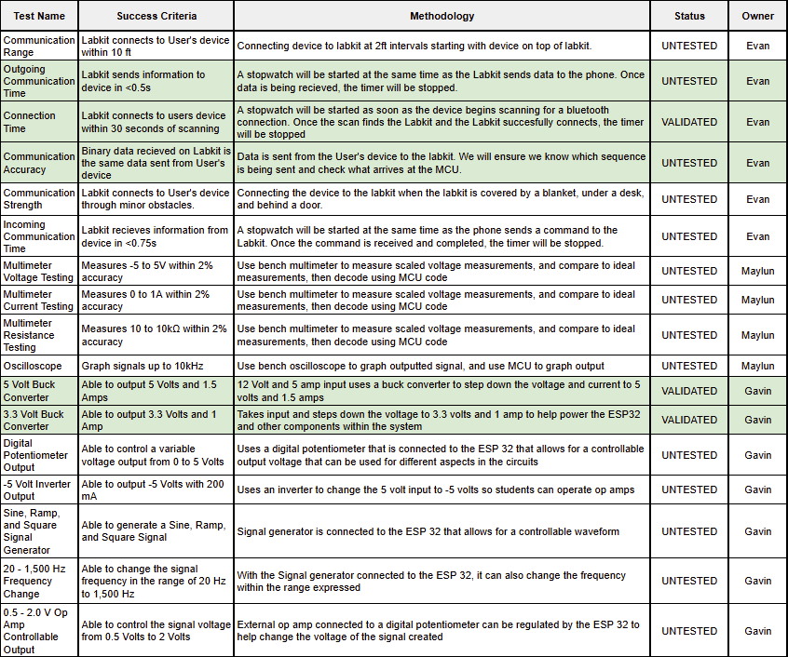
Validation Plan
Notes:
Michelle

Slide 15
Questions?

